Slide 1
Analysis of Northwind Consumer Purchasing Behavior for Northwind
James M. Irving, Ph.D.
Michael Moravetz
04/09/19

Slide 2
QUESTIONS ABOUT CONSUMER PURCHASING BEHAVIOR
Q1: “Do discounts have a statistically significant effect on the number of products customers order? If so, at what level(s) of discount?”
Q2: Do customers spend more money overall if they are buying discounted items?
Q3: Does time of year affect how much consumers buy?
Q4: Do countries that buy discounted items in higher-than-average quantities spend more money (have higher order totals)?

Slide 3
OUR METHODOLOGY
Explored SQL Database for data re: insights into consumer behavior.
Defined formal hypothesis and used the scientific method.
Performed analysis of data distributions to decide appropriate test.
D’Agostino & Pearson’s normality test.
Levene’s test for equal variance.
Performed proper statistical tests to test our hypotheses.
Mann-Whitney U
Tukey’s Pairwise Multiple Comparison tests.

Slide 4
HYPOTHESIS 1: Do discounts have a statistically significant effect on the number of products customers order? If so, at what level(s) of discount?
𝐻1 : Products that are discounted sell in higher quantities.
𝐻0 : Products that are discounted sell the same quantities as full-price products.

Slide 5
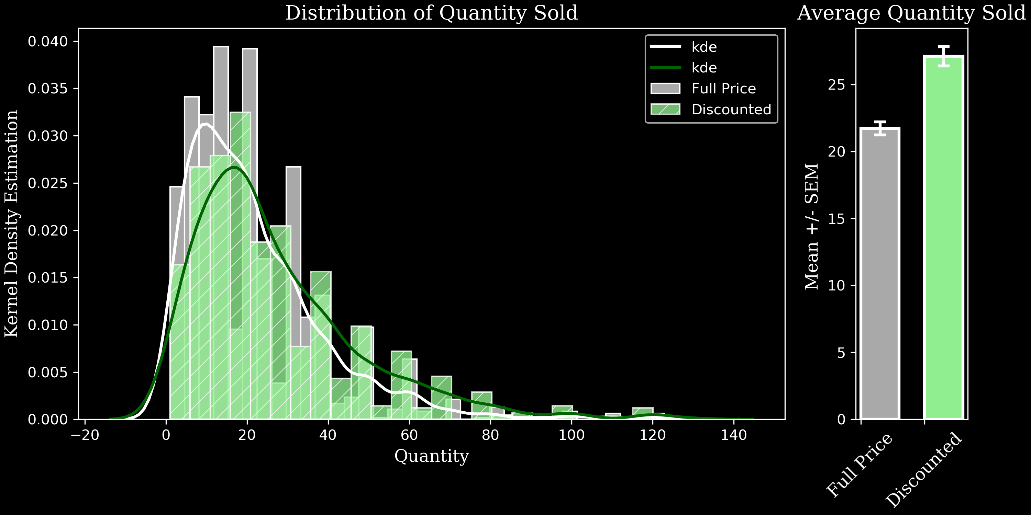
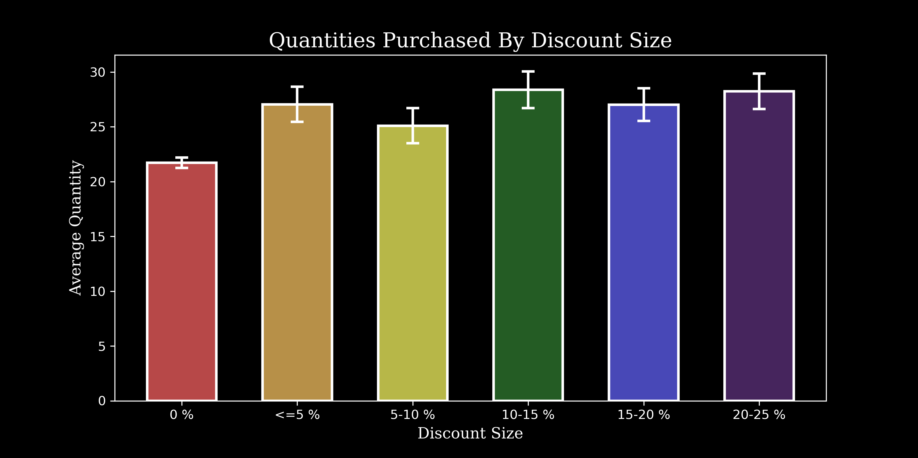
Results:
***
Group | mean | sem | n
Discounted | 27.11 | 0.72 | 838
Full Price | 21.72 | 0.48 | 1317
Consumers buy larger quantities of discounted items.
The level of discount did not have a significant effect on the average quantity purchased.
*
*
*
*
Discount | mean | sem | n
0 % | 21.72 | 0.48 | 1317
<=5 % | 27.05 | 1.61 | 192
5-10 % | 25.10 | 1.61 | 174
10-15 % | 28.38 | 1.67 | 157
15-20 % | 27.02 | 1.48 | 161
20-25 % | 28.24 | 1.62 | 154

Slide 6
HYPOTHESIS 2:
Do customers spend more money if they are buying discounted items?
𝐻1 : Customers spend more money overall when their order includes discounted items.
𝐻0 : Customers spend the same amount regardless of discounted items.

Slide 7
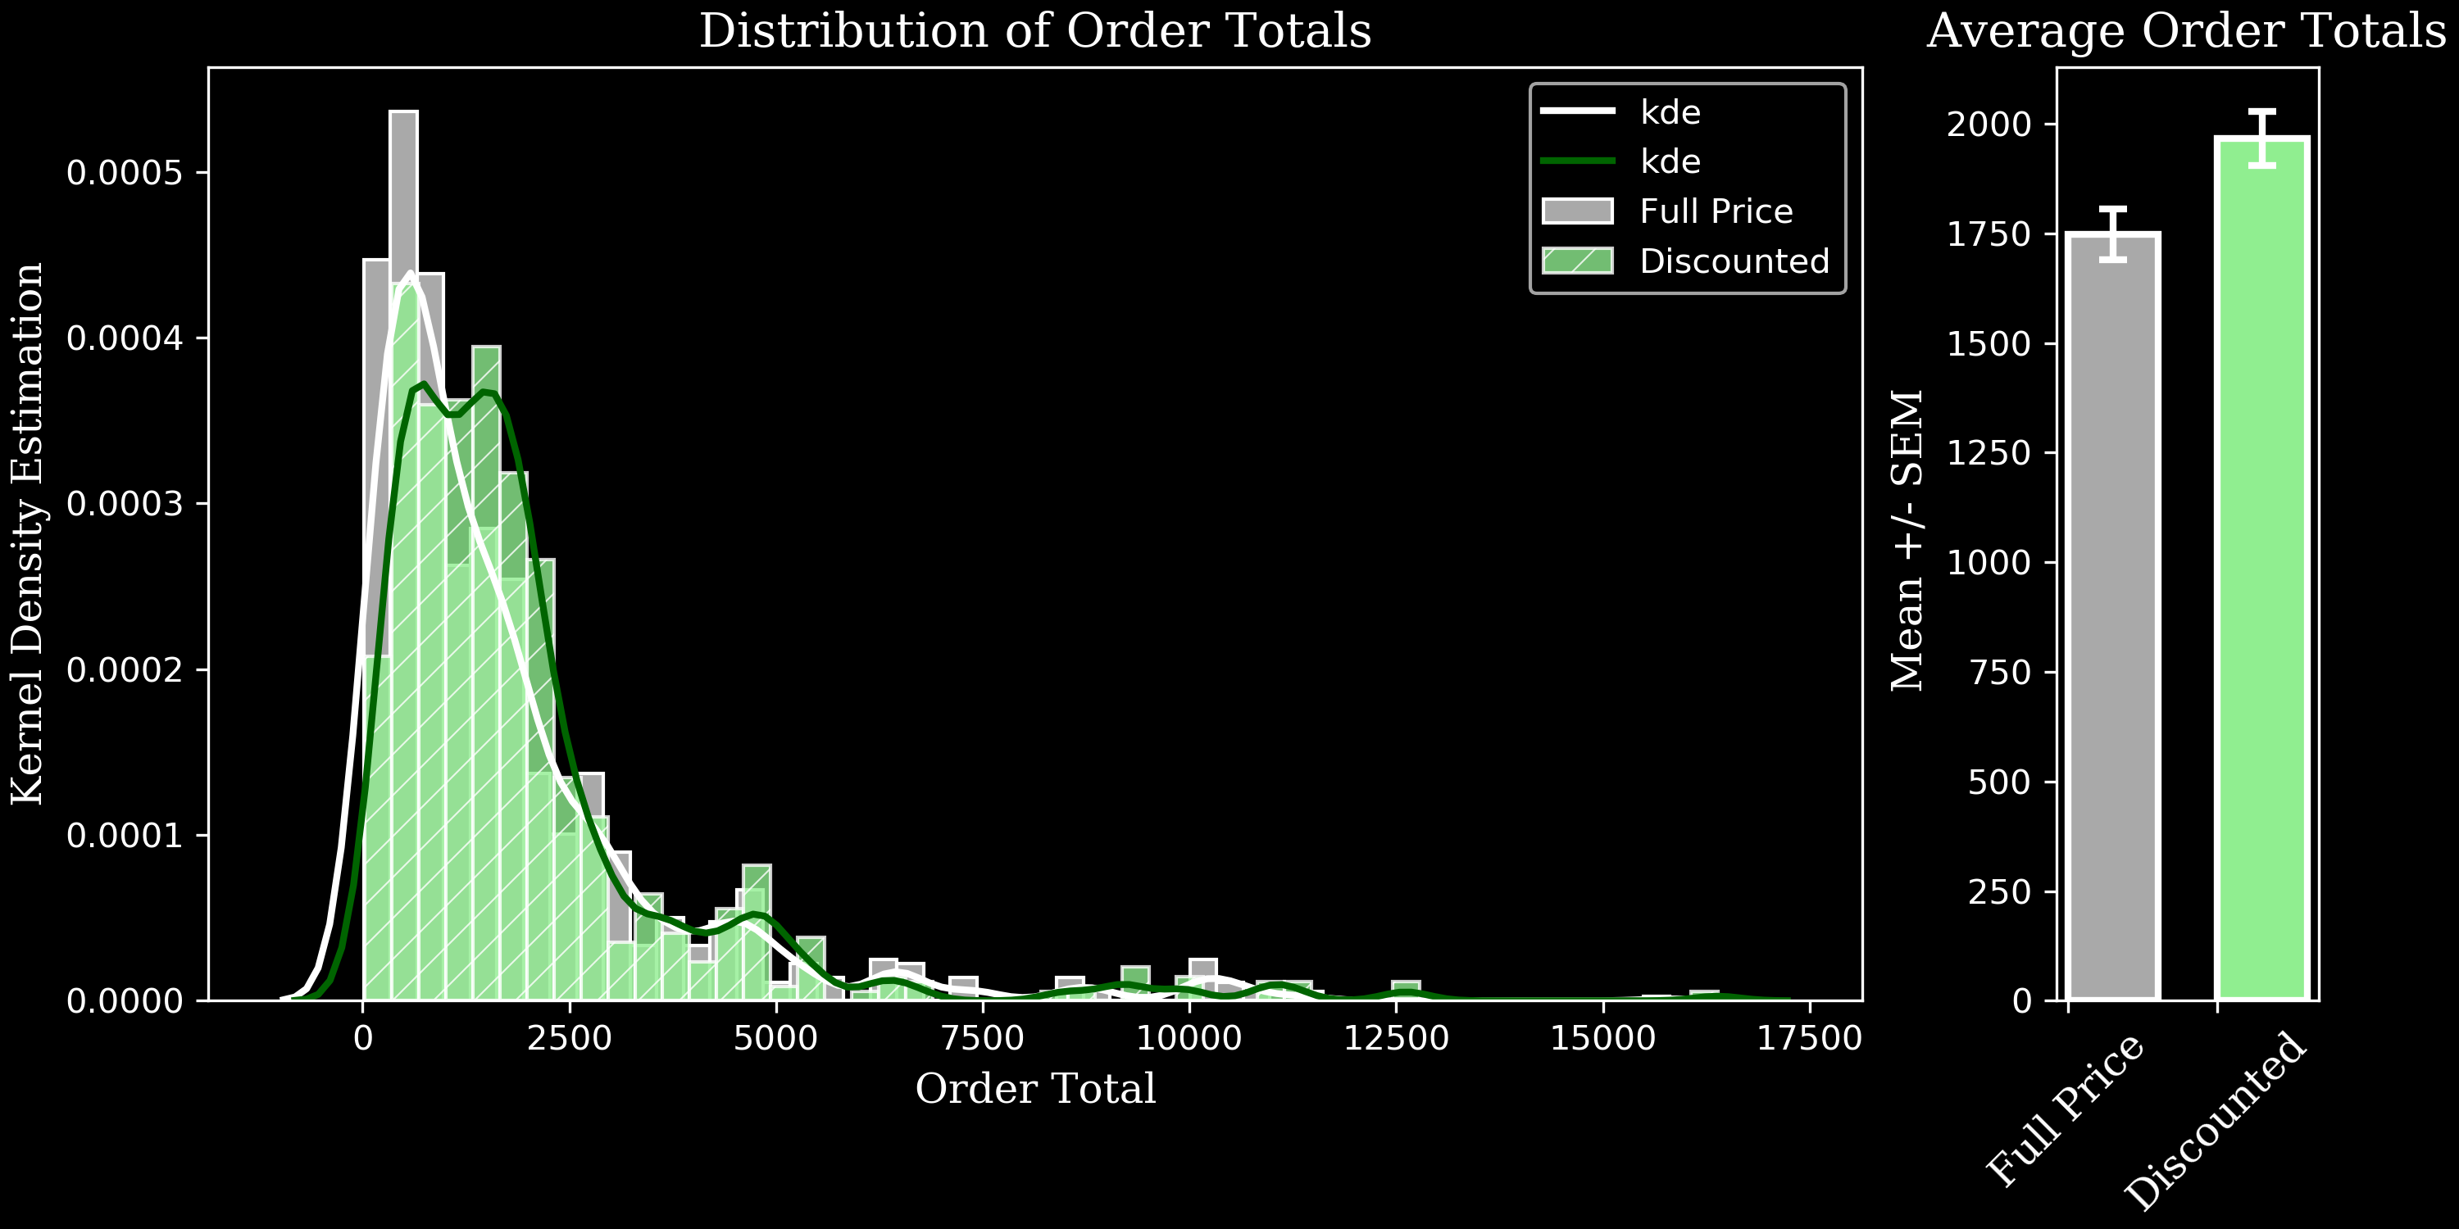
Results:
Consumers spent significantly more money when they were purchasing 1+ products at a discount.
***
Group | mean | sem | n
Discounted Order | 1702.352 | 97.08054 | 380
Full Price Order | 1375.332 | 84.51252 | 450

Slide 8
Hypothesis 3:
Do customers buy different quantities of products depending on the time of year?
H1 : The mean quantities of products sold vary by month.
H0 : The mean quantities of products sold do not change by month.

Slide 9
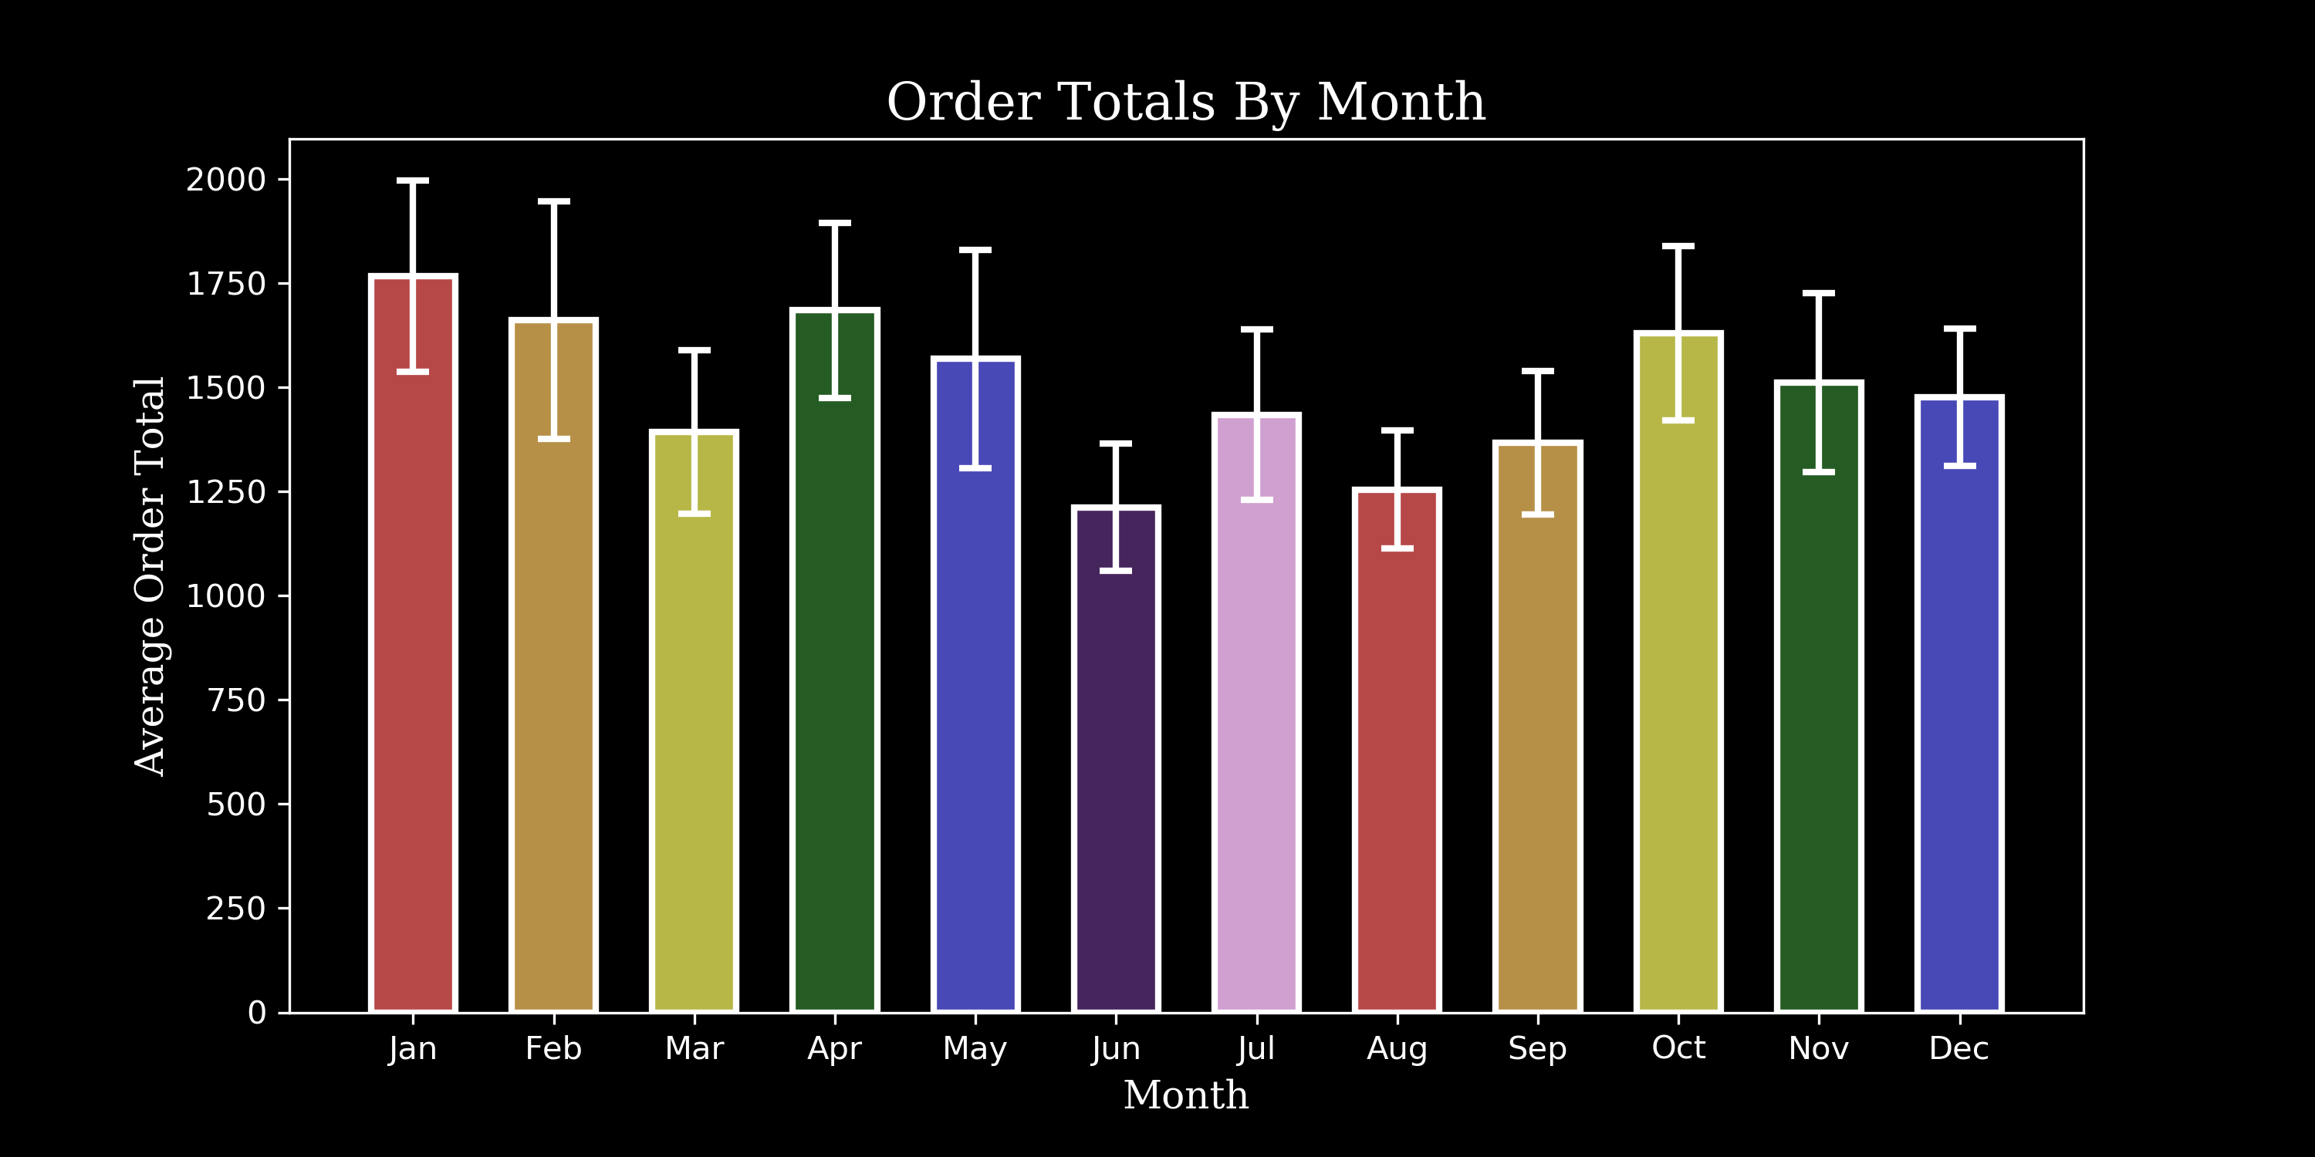
Results:
There was no significant effect of month on order totals.
Group | mean | sem | n
jan | 1766.82 | 229.22 | 88
feb | 1661.43 | 284.95 | 83
mar | 1392.25 | 195.75 | 103
apr | 1684.11 | 210.21 | 105
may | 1567.72 | 261.78 | 46
jun | 1212.09 | 152.38 | 30
jul | 1434.23 | 204.70 | 55
aug | 1254.71 | 141.29 | 58
sep | 1366.84 | 172.44 | 60
oct | 1629.14 | 209.65 | 64
nov | 1510.74 | 215.25 | 59
dec | 1476.43 | 164.97 | 79

Slide 10
Hypothesis 4:
Do countries that buy discounted items in higher-than-average quantities spend more money (have higher order totals)?
H1: Orders shipped to countries where average orders contain higher than average amounts of discounted items per order spend more per order on average than other countries.
H0: Orders shipped to countries where average orders contain higher than average amounts of discounted items per order spend the same per order on average than other countries.

Slide 11
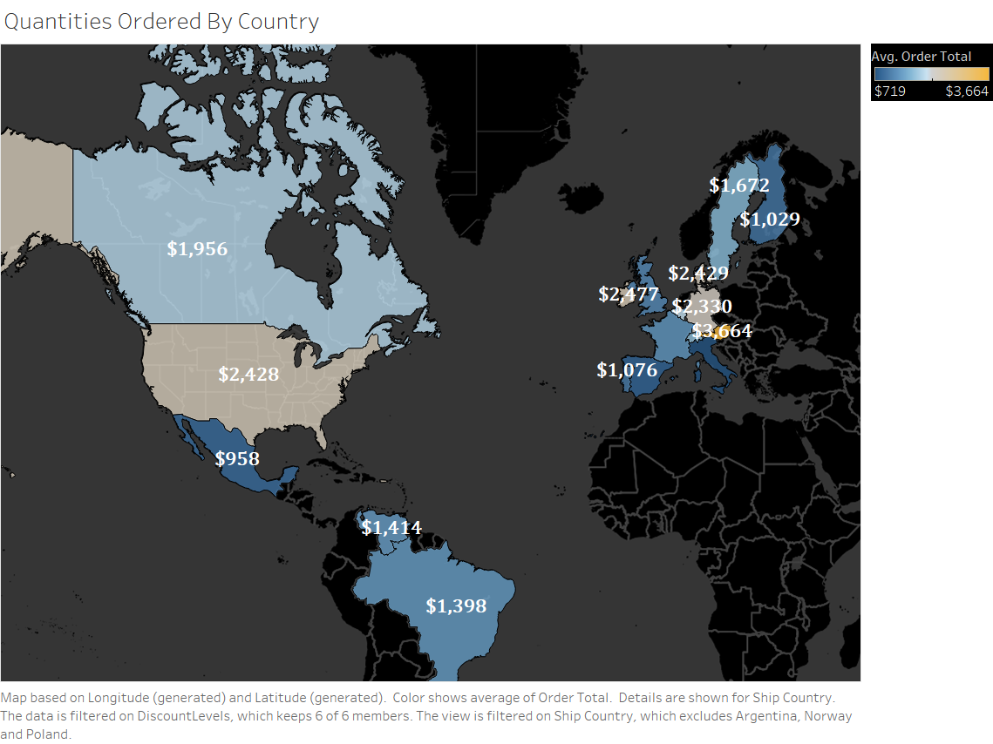
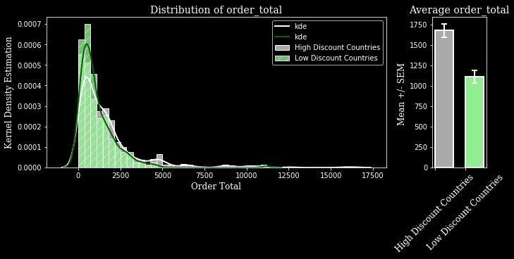
Results:
High Discount Countries spend significantly more money than low discount countries.
TestName | Test Purpose | stat | p | p < .05
normaltest | Normality | 447.1498921 | 7.99162E-98 | TRUE
normaltest | Normality | 215.2311176 | 1.83298E-47 | TRUE
levene | Equal Variance | 13.94809425 | 0.000200801 | TRUE
mannwhitneyu | Hi sig. | 77366.5 | 0.000227103 | TRUE

Slide 12
Recommendations
Discounts spur consumer purchasing behavior.
They buy discounted items in higher quantities.
They spend more money if they are purchasing 1+ discounted items.
Time of year (by month) was not significant, but further metrics worth investigating.
Customers from different countries have unique spending behaviors that may be capitalized on with further investigation.

